Slide 1
Hormones of the Endocrine System

Slide 2
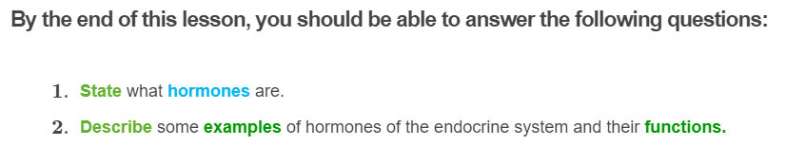
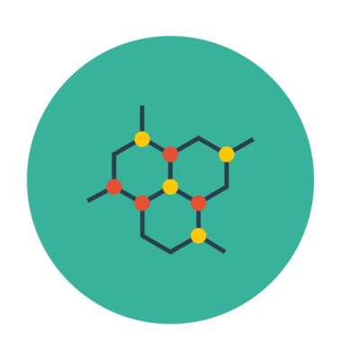

Slide 3
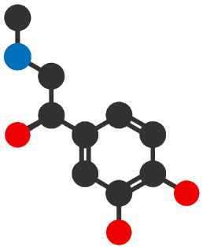
To begin, let's quickly recap what hormones are!
Hormones are chemicals that are produced and secreted (released) from endocrine glands into the bloodstream to send a message to another part of the body. This results in a response on its target cells. Hormones are commonly referred to as chemical messengers.
Different hormones result in different responses in the body. Some hormones can work quickly - over a couple of minutes, while some work over a long period of time.

Slide 4
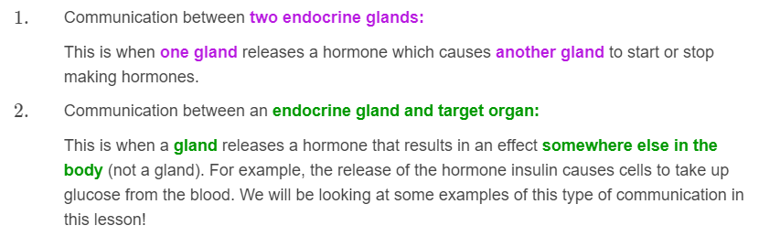
In the body, hormones are used for two types of communication.

Slide 5
Hormones target and affect specific cells
Hormones travel through the bloodstream where they can reach all parts of the body. However, they only bind to cells that have the receptor specifically for that hormone - these cells are called target cells.
Each type of hormone is designed to target and affect specific cells. Only particular cells will display a receptor that recognises a specific type of hormone. This ensures that only cells that display the receptor for the particular hormone are affected.
This means that hormones are receptor-specific.

Slide 6
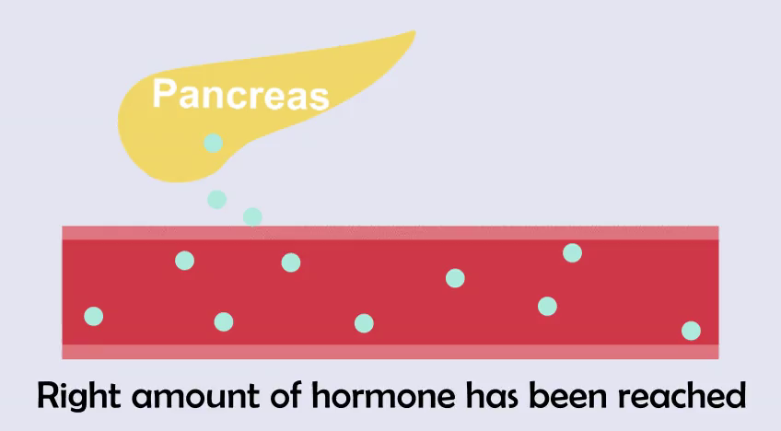
A feedback mechanism prevents too much hormone from being secreted
When a certain amount of hormone has been reached in the bloodstream, this is sensed and information is sent back to the gland so that it stops producing and secreting that hormone.
This is known as a feedback mechanism and prevents too much hormone from being secreted.
Likewise, when levels of the hormone get too low in the bloodstream, the gland is stimulated to start producing that hormone again. This negative feedback loop ensures that the hormone levels in the blood remain within the normal range so that the body can go on functioning!

Slide 7
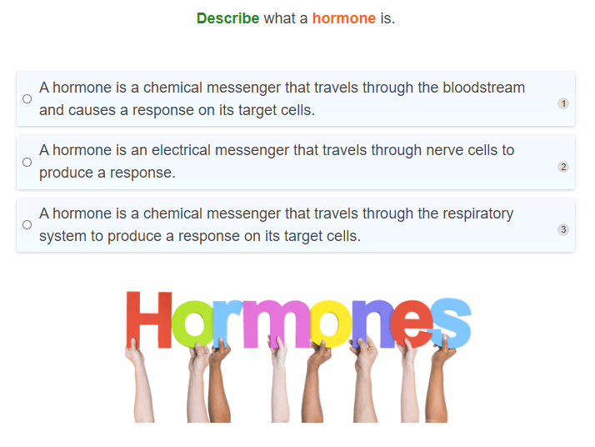

Slide 8
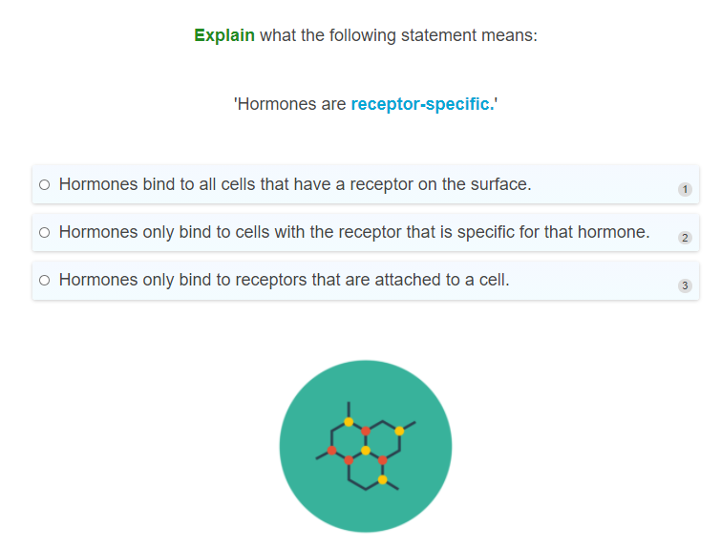

Slide 9
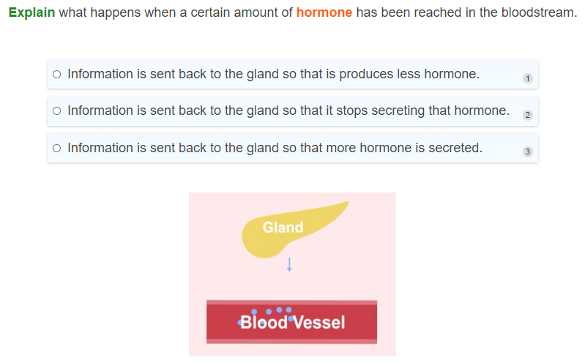

Slide 10
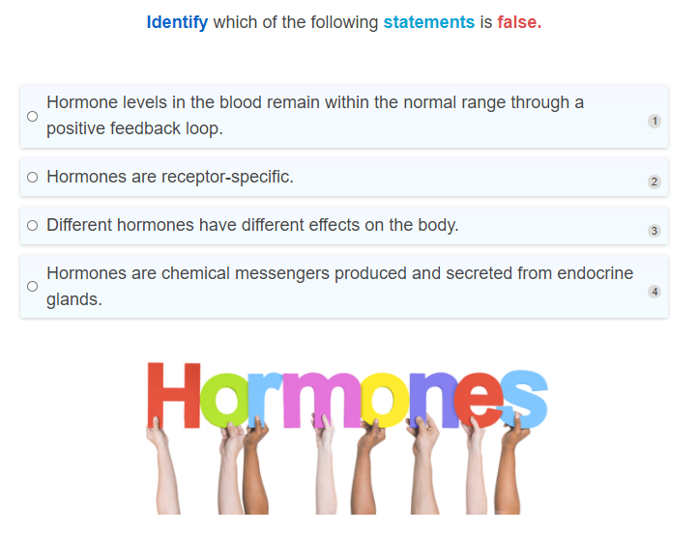

Slide 11
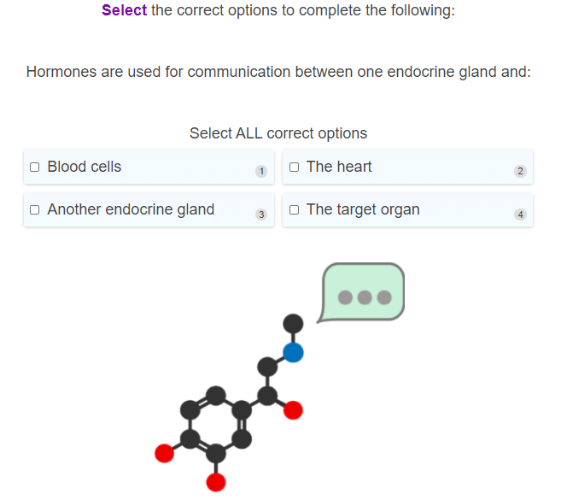

Slide 13
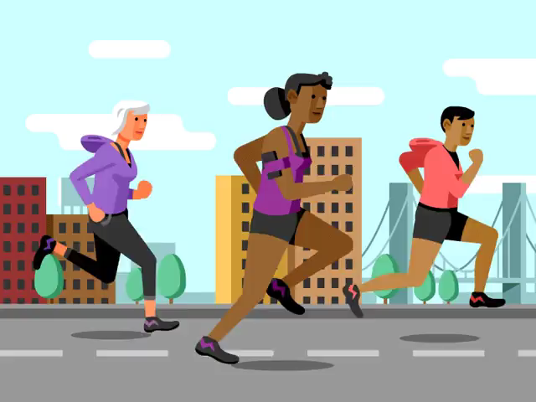
Let's take a look at some of the hormones produced by the endocrine system!
You may be familiar with the hormone adrenaline.
Adrenaline is produced by the adrenal glands (located on top of the kidneys) and released into the bloodstream where it results in a number of responses. This is the hormone that prepares your body to deal with stressful situations, such as intense exercise, fright or dangerous situations.

Slide 14

Adrenaline triggers the 'fight or flight response' (or the sympathetic nervous system) to be activated.
You may recall this from the nervous system module.
Essentially this response prepares the body to respond to stress and 'fight' or run away from the threat.
These responses can include: an increased heart rate and blood pressure, sweating, and dilation (expansion) of air passages to allow more oxygen to enter the body and reach the muscles.

Slide 15
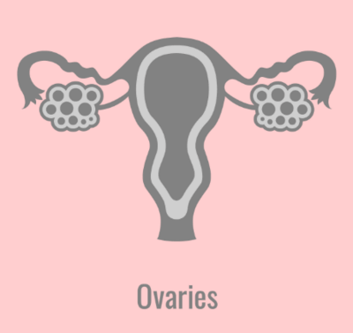
Oestrogen
Oestrogen is a hormone that is mainly produced from the ovaries and is one of the main sex hormones in women.
Oestrogen is responsible for the changes that are seen during puberty in females.
These changes include the growth of the breasts, pubic and underarm hair, and the start of menstrual cycles (periods).

Slide 16
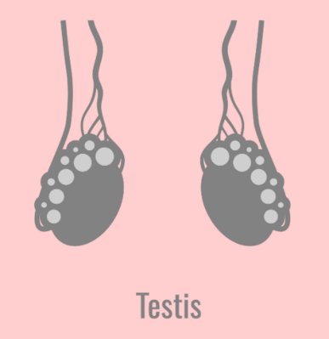
Testosterone
Testosterone is the main sex hormone found in men and is produced by the testes.
This hormone is responsible for the physical changes in males during puberty.
These changes include: growth of facial, pubic and body hair, deepening of the voice, building muscles strength and strong bones.

Slide 17
Growth Hormone
Growth hormone, also known as somatotropin, is produced and secreted by the pituitary gland (found in the brain, below the hypothalamus).
This hormone is responsible for controlling your body's growth. It is the hormone that helps you to grow taller, and stimulates the growth of all the tissues in the body, like muscles and bone.
Growth hormone is also involved in controlling the body's metabolism - the process where cells convert glucose into energy.

Slide 18
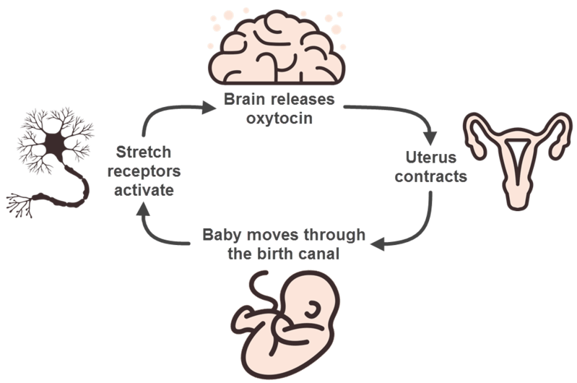
Oxytocin
Oxytocin is a hormone produced by the hypothalamus and secreted by the pituitary gland in the brain.
This hormone has an important role in women during childbirth. It causes the muscles in the uterus (womb) to contract during childbirth so that the baby can be pushed out of the birth canal.
During childbirth oxytocin is controlled by a positive feedback mechanism. This means that the release of oxytocin stimulates more oxytocin to be released. This is important to ensure that the muscles in the uterus continue to contract until the baby is born.

Slide 19
Antidiurectic Hormone
Antidiurectic hormone (ADH) is made by the hypothalamus in the brain and secreted and stored by the pituitary gland.
Antidiurectic hormone is released from the pituitary gland into the bloodstream when there is a low blood pressure or not enough water in the blood.
It tells your kidneys to conserve water by getting the kidneys to reduce the amount of water that is passed out as urine, and taking the water back into the bloodstream. This will increase the blood pressure, returning it back to normal.

Slide 20
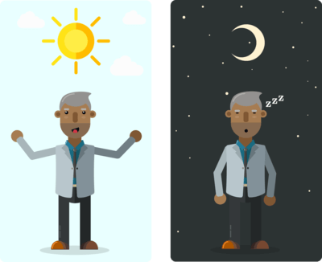
Melatonin
Melatonin is mainly produced by the pineal gland in the brain.
Light is an important factor that controls the production and secretion of melatonin. When there is a lot of light, such as during the day, melatonin production is generally inhibited.
This means that melatonin levels are the highest during the night when it is dark.
This hormone generally helps us to sleep better at night and regulates our sleep and waking cycles so that we feel sleepy during the night and alert during the day.

Slide 21
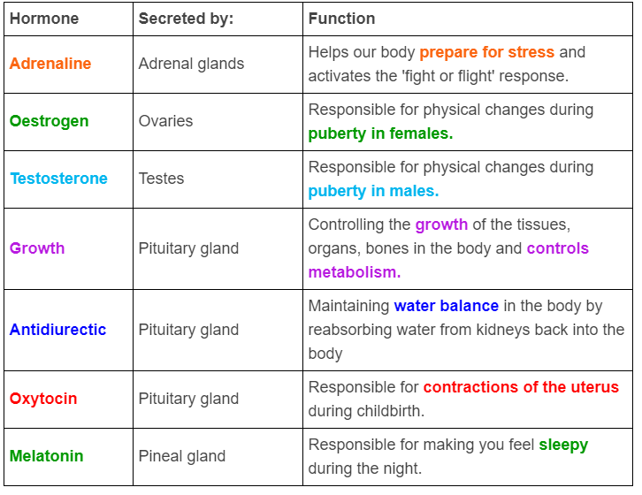
The table below summarises the endocrine hormones we have learnt in this section.

Slide 22
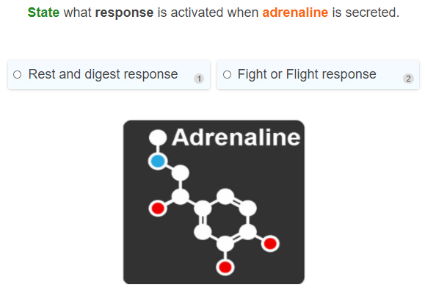

Slide 23
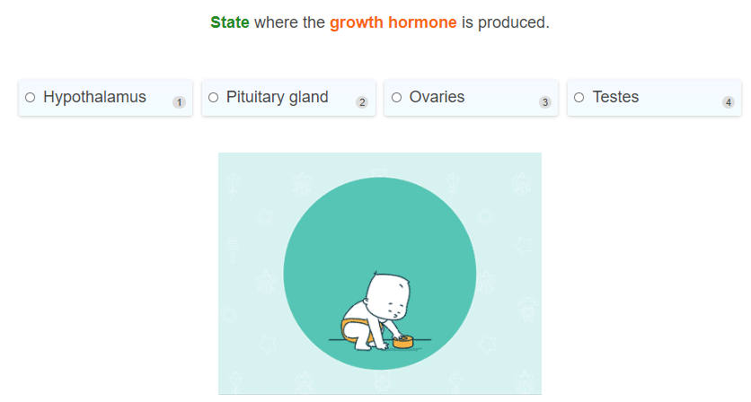

Slide 24
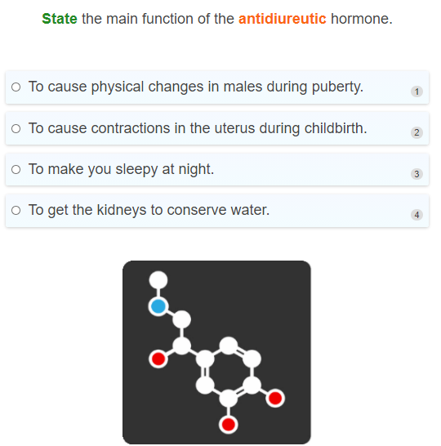

Slide 25
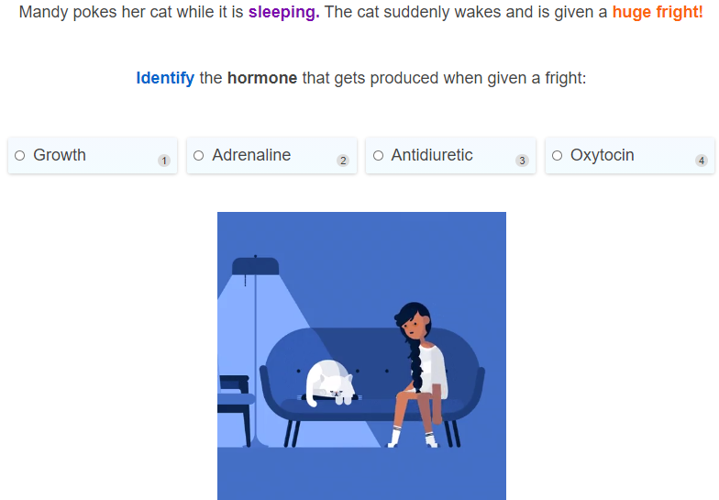

Slide 26
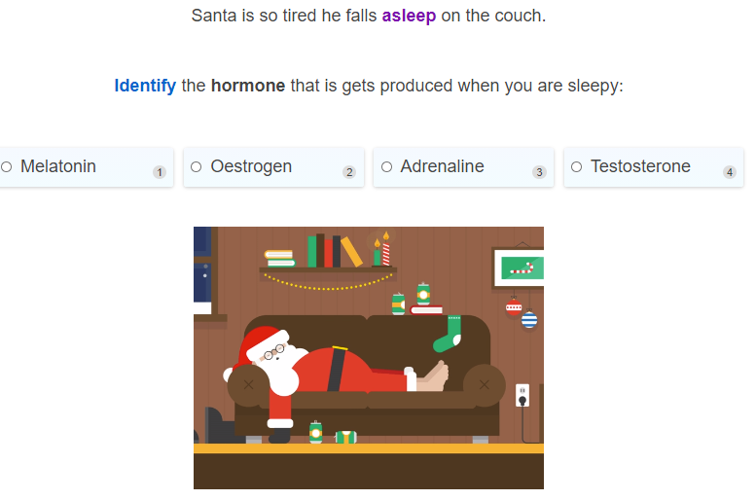

Slide 27
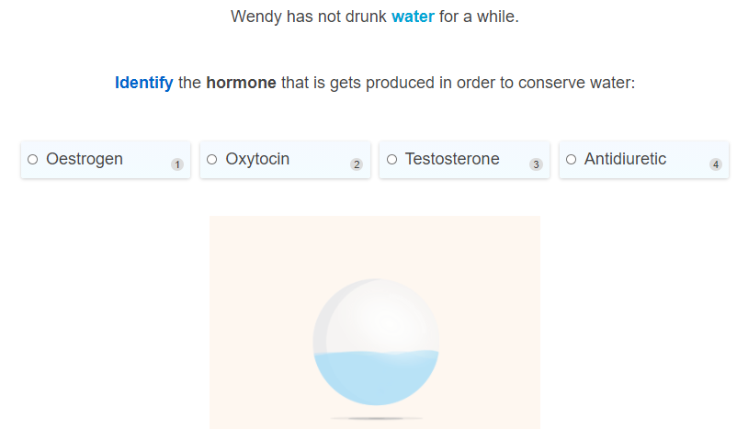

Slide 28
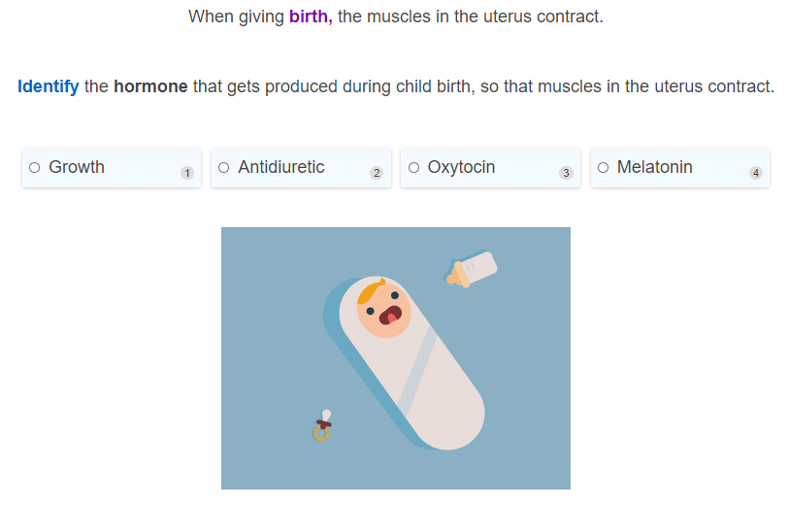

Slide 29
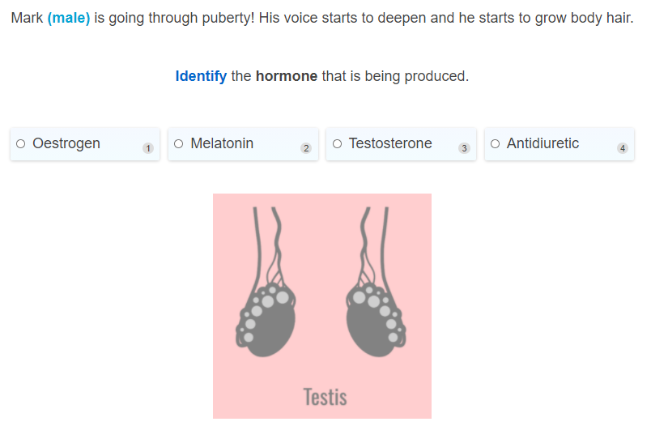

Slide 30
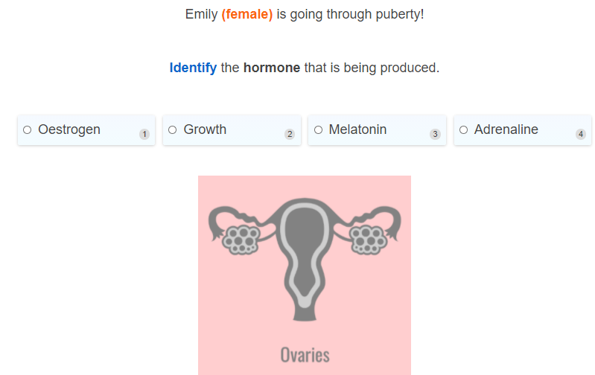

Slide 31
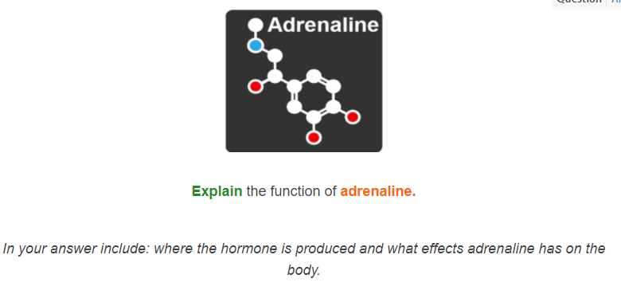

Slide 32
